Slide 1
Computer Arithmetic - Supplement
Fast Addition
  Carry-Lookahead
  Carry-Skip
  Carry Select
  Carry-Save

Slide 2
Problem: ripple carry adder is slow
Is a 32-bit ALU as fast as a 1-bit ALU?
Can you see the ripple? How could you get rid of it?
direct substitution
c₁ = b₀c₀ + a₀c₀ + a₀b₀
c₂ = b₁c₁ + a₁c₁ + a₁b₁ c₂ =
c₃ = b₂c₂ + a₂c₂ + a₂b₂ c₃ =
c₄ = b₃c₃ + a₃c₃ + a₃b₃ c₄ =
Not feasible! Why?

Slide 3
Ripple-Carry Adders
Critical Delay
  The propagation of carry from low to high order stages
Cin
A
4 stage
adder
B
Cin
S
A0
S0 @2
B0
C1 @2
@0
@0
A
@1
@N+1
B
A1
S1 @3
@N
Cin
B1
C2 @4
Cout
@0
@0
A
@N+2
B
@1
A2
S2 @5
B2
C3 @6
late
arriving
signal
two gate delays
to compute Cout
A3
S3 @7
B3
Cout @8

Slide 4
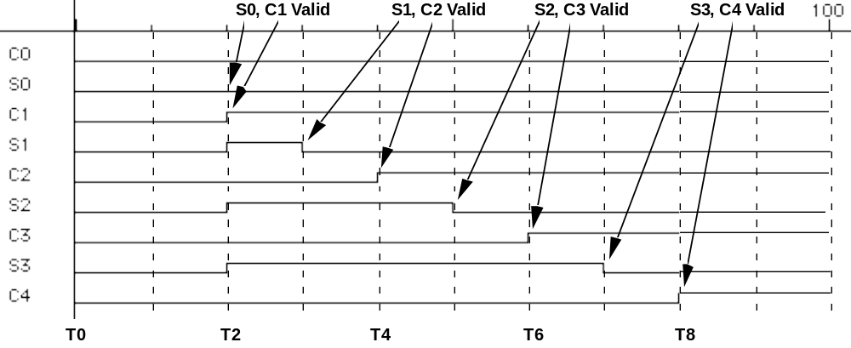
Ripple-Carry Adders (cont’d)
Critical delay
  The propagation of carry from low to high order stages
  1111 + 0001 is the worst case addition
  Carry must propagate through all bits

Slide 5
Carry-lookahead adder
An approach in-between our two extremes
  When would we always generate a carry? g_{i} = a_{i} b_{i}
  When would we propagate the carry? p_{i} = a_{i} + b_{i}
Rewrite Full-adder:
S_{i} = a_{i} XOR b_{i} XOR C_{i} (= p_{i XOR} C_{i})
C_{i+1 =} g_{i} + p_{i} C_{i}
Did we get rid of the ripple?
c₁ = g₀ + p₀c₀
c₂ = g₁ + p₁c₁ c₂ =
c₃ = g₂ + p₂c₂ c₃ =
c₄ = g₃ + p₃c₃ c₄ =
Feasible! Why?

Slide 6
Carry-Lookahead Logic
Carry generate: Gi = Ai Bi
  Must generate carry when A = B = 1
Carry propagate: Pi = Ai xor Bi
  Carry-in will equal carry-out here
Sum and Cout can be re-expressed in terms of generate/propagate:
  Si = Ai xor Bi xor Ci
  = Pi xor Ci
  Ci+1= Ai Bi + Ai Ci + Bi Ci
  = Ai Bi + Ci (Ai + Bi)
  = Ai Bi + Ci (Ai xor Bi)
  = Gi + Ci Pi

Slide 7
Carry-Lookahead Logic (cont’d)
Re-express the carry logic as follows:
  C1 = G0 + P0 C0
  C2 = G1 + P1 C1 = G1 + P1 G0 + P1 P0 C0
  C3 = G2 + P2 C2 = G2 + P2 G1 + P2 P1 G0 + P2 P1 P0 C0
  C4 = G3 + P3 C3 = G3 + P3 G2 + P3 P2 G1 + P3 P2 P1 G0 + P3 P2 P1 P0 C0
Each of the carry equations can be implemented with two-level logic
  All carries are now directly derived from data inputs and not from intermediate carries
  this allows computation of all sum outputs to proceed in parallel
    Pi & Gi from input : 1 gate delay; Ci from Pi&Gi: 2 gate delay
    Sum available 1 gate delay later than Ci

Slide 8
Carry-Lookahead Implementation
Adder with propagate and generate outputs
Ai
Pi @ 1 gate delay
Bi
Ci
Si @ 2 gate delays
increasingly complex
logic for carries wrt. bits
Gi @ 1 gate delay
C0
C0
@ 2 gate delays
C0
P0
C1
P0
P0
G0
P1
P1
P2
P2
G0
P3
C0
P1
G0
P0
P2
P1
P1
G1
C3
P2
G0
P2
P3
@ 3 gate delays
P1
C2
G1
G2
P2
G1
P3
G2
C4
P3
G3

Slide 9
Carry-Lookahead Implementation (cont’d)
Carry-lookahead logic generates individual carries
  Sums computed much more quickly in parallel
  However, cost of carry logic increases with more stages
Cin
Cin
A0
S0 @2
A0
S0 @2
B0
B0
C1 @2
C1 @3
A1
S1 @4
A1
S1 @3
B1
B1
C2 @4
C2 @3
A2
S2 @4
A2
S2 @5
B2
B2
C3 @6
C3 @3
A3
S3 @4
A3
S3 @7
B3
B3
Cout @8
C4 @3
C4 @3

Slide 10
Use principle to build bigger adders
Can’t build a 16 bit adder this way... (too big)
  Note that C16 needs an AND gate of 17 Fan-in
Could use ripple carry of 4-bit CLA adders (seen below)
Cascading 4-bit CLAs: 1+2 + (n/4 – 1)2 + 1 gate delays for n-bit
10 gate delays compared to 32 gate delays for 16-bit ripple-carry adder
4-bit CLA
4-bit CLA
4-bit CLA
4-bit CLA
Better Way?

Slide 11
Better Approach - Hierarchical CLA
C
a
r
r
y
I
n
use the CLA principle again!
Group generate:
G = g₃ + p₃ g₂ + p₃ p₂ g₁ + p₃ p₂ p₁ g₀
i.e. regardless of c₀, C₄=1
Group propagate:
P= p₃ p₂ p₁ p₀
i.e. c₄ =1 if c₀ =1
Note: P takes 2gate delays
G takes 3gate delays
because p_{i and} g_{i:} 1 gate delay
C4=G+PC0 4 gate delays
a
0
C
a
r
r
y
I
n
b
0
R
e
s
u
l
t
0
-
-
3
a
1
b
1
A
L
U
0
a
2
P
0
p
i
b
2
G
0
g
i
a
3
b
3
C
a
r
r
y
-
l
o
o
k
a
h
e
a
d
u
n
i
t
C
1
c
i
+
1
a
4
C
a
r
r
y
I
n
b
4
R
e
s
u
l
t
4
-
-
7
a
5
b
5
A
L
U
1
a
6
P
1
p
i
+
1
b
6
G
1
g
i
+
1
a
7
b
7
C
2
c
i
+
2
a
8
C
a
r
r
y
I
n
b
8
R
e
s
u
l
t
8
-
-
1
1
a
9
a
b
9
A
L
U
2
b
1
0
P
2
p
i
+
2
a
1
0
G
2
g
i
+
2
b
1
1
1
1
C
3
c
i
+
3
a
1
2
C
a
r
r
y
I
n
b
1
2
R
e
s
u
l
t
1
2
-
-
1
5
a
1
3
b
1
3
A
L
U
3
a
1
4
P
3
p
i
+
3
b
1
4
G
3
g
i
+
3
a
1
5
C
4
c
i
+
4
b
1
5
C
a
r
r
y
O
u
t

Slide 12
Hierarchical Carry-Lookahead Adder
Group carry propagate and Group carry generate
  G0= g3 + p3 g2 + p3 p2 g1 + p3 p2 p1 g0 @3
  P0 = p3p2p1p0 @2; S[3-0] @4
  C1 = G0 + P0C0 = C4 @4
For the next 4-bit positions [7-4]
  G1= G7 + P7 G6 + P6 P5 G5 + P7 P6 P5 G4 @3
  P1 = P7P6P5P4 @2
  C2 = G1 + P1 C1 = G1 + P1 G0 + P1 P0 @5
  S[7-5] @7 (C7~C5: 2 gate delay after C4 available)
Except the first group,
Sum available after 3 gate delay from carry-in available
  internal carries available 2 gate later than carry-in
Carry-out available after 2 gate delay from G available

Slide 13
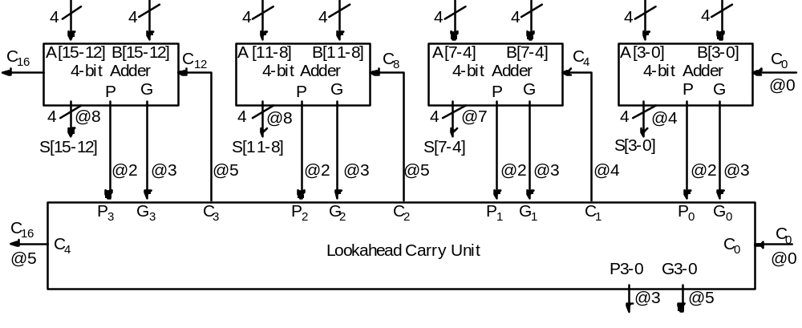
16-bit Hierarchical CLA
Note: try to follow the timing for gate delays

Slide 14
4-bit CLA
4-bit Carry Generation
Carry Generation Logic:
c₁ = g₀ + p₀c₀
c₂ = g₁ + p₁g₀ + p₁p₀c₀
c₃ = g₂ + p₂ g₁ + p₂ p₁ g₀ + p₂ p₁ p₀c₀
c₄ = g₃ + p₃ g₂ + p₃ p₂ g₁ + p₃ p₂ p₁ g₀ + p₃ p₂ p₁ p₀c₀
Note: 1 gate delay for p, g
2 gate delays for c
1 gate delay for S

Slide 15
Use principle to build bigger adders
Can’t build a 16 bit adder this way... (too big)
  Note that C16 needs an AND gate of 17 Fan-in
Could use ripple carry of 4-bit CLA adders (seen below)
Cascading 4-bit CLAs: 1+2 + (n/4 – 1)2 + 1 gate delays for n-bit
10 gate delays compared to 32 gate delays for 16-bit ripple-carry adder
4-bit CLA
4-bit CLA
4-bit CLA
4-bit CLA

Slide 16
Better Approach - Hierarchical CLA
C
a
r
r
y
I
n
use the CLA principle again!
Group generate:
G = g₃ + p₃ g₂ + p₃ p₂ g₁ + p₃ p₂ p₁ g₀
i.e. regardless of c₀, C₄=1
Group propagate:
P= p₃ p₂ p₁ p₀
i.e. c₄ =1 if c₀ =1
Note: P takes 2gate delays
G takes 3gate delays
because p_{i and} g_{i:} 1 gate delay
a
0
C
a
r
r
y
I
n
b
0
R
e
s
u
l
t
0
-
-
3
a
1
b
1
A
L
U
0
a
2
P
0
p
i
b
2
G
0
g
i
a
3
b
3
C
a
r
r
y
-
l
o
o
k
a
h
e
a
d
u
n
i
t
C
1
c
i
+
1
a
4
C
a
r
r
y
I
n
b
4
R
e
s
u
l
t
4
-
-
7
a
5
b
5
A
L
U
1
a
6
P
1
p
i
+
1
b
6
G
1
g
i
+
1
a
7
b
7
C
2
c
i
+
2
a
8
C
a
r
r
y
I
n
b
8
R
e
s
u
l
t
8
-
-
1
1
a
9
a
b
9
A
L
U
2
b
1
0
P
2
p
i
+
2
a
1
0
G
2
g
i
+
2
b
1
1
1
1
C
3
c
i
+
3
a
1
2
C
a
r
r
y
I
n
b
1
2
R
e
s
u
l
t
1
2
-
-
1
5
a
1
3
b
1
3
A
L
U
3
a
1
4
P
3
p
i
+
3
b
1
4
G
3
g
i
+
3
a
1
5
C
4
c
i
+
4
b
1
5
C
a
r
r
y
O
u
t

Slide 17
16-bit Hierarchical CLA
Note: try to follow the timing for gate delays

Slide 18
Other Adder Types
Carry Skip Adder
Note if P: carry propagate =1 and carry-in = 1
Then carry-out = 1 regardless of G: carry generate
Carry Select Adder
(Don’t abbreviate to CSA because it is reserved for other adder type)
Two parallel additions with carry-in =0 and 1

Slide 19
Carry Skip Adder
Simpler than CLA by generating P_{i} ‘s only
e.g. 20 bit adder using 4 bit groups (see next page)
P _{i,j} = P_{i}….P_{i+1}….P _{j}
  If P _{i,j} = 1 and c_{j} = 1,
  then carry needs to propagate to next group, i.e. skip the block

Slide 20
20-bit Carry skip adder
4
4
Add ₄
C₁₂
Add ₃
C₈
Add ₂
C₄
4 bit Add ₁
C₀
C₁₆
,
P_{12,15}
P_{8,11}
P_{4,7}
C₂₀
Add₅
If C4 = 1 and P4,7=1 then C8 = 1 w.o. waiting for Add2:Carry Skip Adder
Assume 4-bit carry-ripple adder.

Slide 21
20-bit Carry Skip Adder (cont.)
All Adder generate carry using C _{in} = 0
After C₄ comes out of Add₁,
If P_{4,7} =1 & C₄ =1, then C₈ =1
Repeating this, C₁₂ & C₁₆ can be determined if they are 1.
Total gate delay (for best case),
First 4-bit and last 4-bit addition plus
carry-skipped blocks (= 20/4 - 2)
(4+(20/4 –2) +4) *2 gate delays
For worst case, i.e. no carry skips,
It becomes carry-ripple adder

Slide 22
Carry Skip Adder (Cont..)
t₀ t₁ t₂ t₃ t₄ t₅ t₆ t₇ t₈ t₉ t₁₀ t₁₁
add₁ add₂
C₈ add₃
C₁₂ add₄
C₁₆
add₅
1 time unit = 2 gate delays

Slide 23
8-bit Carry Select Adder
4
4
0
C₄
C₀
1
S₃
S₀
Mux
4

Slide 24
Carry Select Adder
Add in parallel for two cases of C _{in}= 0 & 1.
Twice faster at 50% more hardware.
NOTE: # of bits in a group change time-delay for Carry skip & Carry select.
Combination of adder types for an adder w.r.t. technology, area, delay.

Slide 25
Carry Save Adder (CSA)
CSA : 3 inputs & 2 outputs
; just a collection of n independent FA s
No carry propagation
; when adding partial products in multiplication , no need to propagate carry
until the last step

Slide 26
CSA - motivation
e.g. 4 bit (P + Y → P )
P₃ P₂ P₁ P₀
Y₃ Y₂ Y₁ Y₀
+----------------------------------
sum: P₃+Y₃ P₂+Y₂ P₁+Y₁ P₀+Y₀ → shift
carry: C₄ C₃ C₂ C₁
Next time to add Y
P₃+Y₃ P₂+Y₂ P₁+Y₁
C₄ C₃ C₂ C₁
Y₃ Y₂ Y₁ Y₀
+---------------------------------------------
No carry propagation , 2 gate delay for any n- bit.

Slide 27
Using CSA for multiplication
m⁰₃ m⁰₂ m⁰₁ m⁰₀
m¹₃ m¹₂ m¹₁ m¹₀
m²₃ m²₂ m²₁ m²₀
m³₃ m³₂ m³₁ m³₀
+----------------------------------------------------
P₇ P₆ P₅ P₄ P₃ P₂ P₁ P₀

Slide 28
Using CSA (cont..)
        0 0 0 0
        m⁰₃ m⁰₂ m⁰₁ m⁰₀
        m¹₃ m¹₂ m¹₁ m¹₀
        ^{CSA}
        s₃ s₂ s₁ s₀
        c₄ c₃ c₂ c₁
        m²₃ m²₂ m²₁ m²₀
        ^{CSA} s₃ s₂ s₁ s₀
        c₄ c₃ c₂ c₁
        m³₃ m³₂ m³₁ m³₀
        ^{CSA}
        s₃ s₂ s₁ s₀
        c₄ c₃ c₂ c₁
P₇ P₆ P₅ P₄ P₃ P₂ P₁ P₀

Slide 29
CSA for multiplication
For n-bit multiplication,
(n-1) CSA’s
Plus 1 propagate adder
Note each CSA takes
Only 2 gate delays
Regardless of n
CSA
C _{i}
S _{i}
CSA
CSA
Propagate Adder
P₇ P₆ P₅ P₄ P₃ P₂ P₁ P₀

